Slide 1
Zener Diode

Slide 2
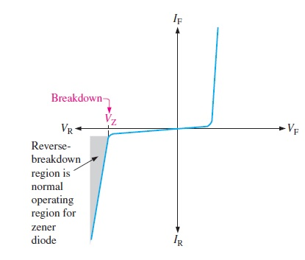
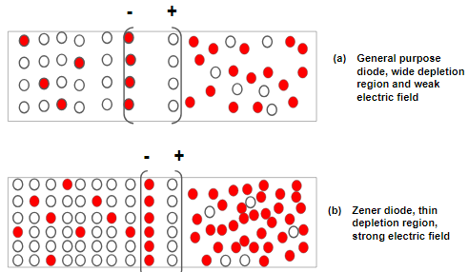
A zener diode is a silicon pn junction device that is designed for operation in the reverse-breakdown region. The breakdown voltage of a zener diode is set by carefully controlling the doping level during manufacture

Slide 3
Zener Breakdown
Zener diodes are designed to operate in reverse breakdown. Two types of reverse breakdown in a zener diode are avalanche and zener. The avalanche effect, discussed in simple diode, occurs in both rectifier and zener diodes at a sufficiently high reverse voltage.
Zener Breakdown occurs in a zener diode at low reverse voltages. A zener diode is heavily doped to reduce the breakdown voltage. This causes a very thin depletion region. As a result, an intense electric field exists within the depletion region. Near the zener breakdown voltage (VZ), the field is intense enough to pull electrons from their valence bands and create current.

Slide 4
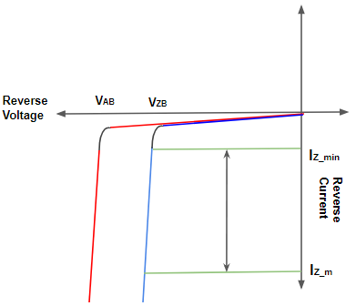
Difference between Avalanche and Zener Breakdown
In avalanche breakdown high heat energy produces due to collision between the electrons. Actually when high energy free electrons enter in the depletion region from p-type area. They collide with electrons in the valence shells of atoms in the depletion region. They produces more free electrons. Hence heat energy and large current produces which causes avalanche breakdown. But in zener breakdown the electrons are pulled out of valence shell with the help of strong electric field rather than collision.

Slide 5
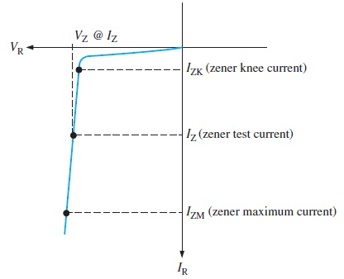
Breakdown Characteristics
Figure 3–3 shows the reverse portion of a zener diode’s characteristic curve. Notice that as the reverse voltage (VR) is increased, the reverse current (IR) remains extremely small up to the “knee” of the curve. The reverse current is also called the zener current, IZ
At this point, the breakdown effect begins; the internal zener resistance, also called zener impedance (ZZ), begins to decrease as the reverse current increases rapidly. From the bottom of the knee, the zener breakdown voltage (VZ) remains essentially constant although it increases slightly as the zener current, IZ, increases.

Slide 6
Zener Regulation
The ability to keep the reverse voltage across its terminals essentially constant is the key feature of the zener diode. A zener diode operating in breakdown acts as a voltage regulator because it maintains a nearly constant voltage across its terminals over a specified range of reverse-current values.
A minimum value of reverse current, IZK, must be maintained in order to keep the diode in breakdown for voltage regulation. You can see on the curve in Figure 3–3 that when the reverse current is reduced below the knee of the curve, the voltage decreases drastically and regulation is lost. Also, there is a maximum current, IZM, above which the diode may be damaged due to excessive power dissipation. So, basically, the zener diode maintains a nearly constant voltage across its terminals for values of reverse current ranging from IZK to IZM. A nominal zener voltage, VZ, is usually specified on a datasheet at a value of reverse current called the zener test current.

Slide 7
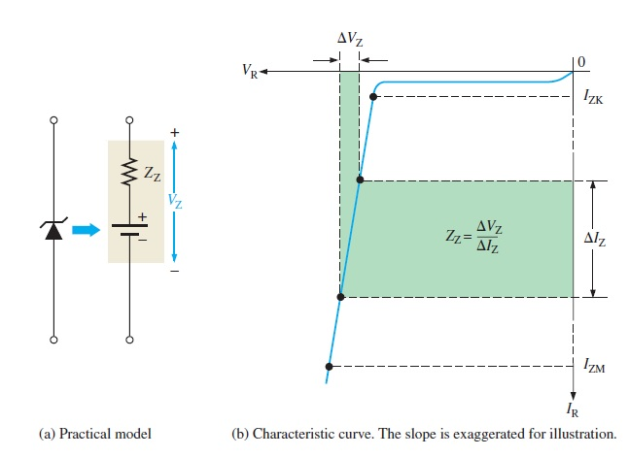
Zener Impedance (Resistance)

Slide 8
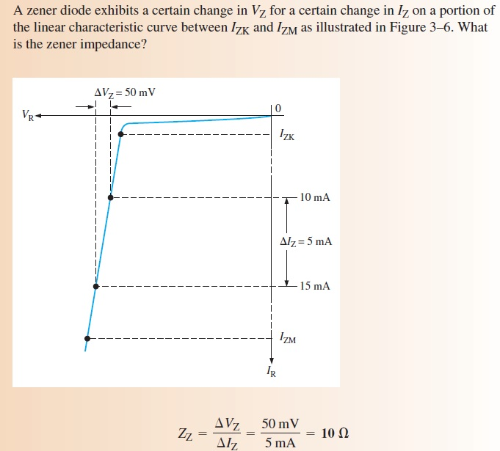

Slide 9
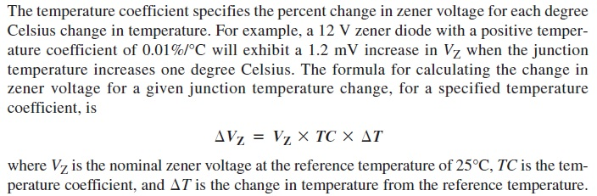
Temperature Coefficient

Slide 10
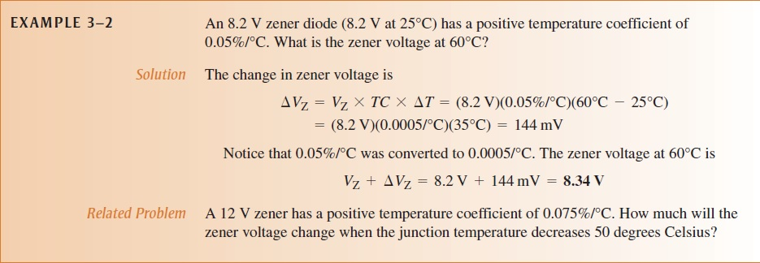

Slide 11
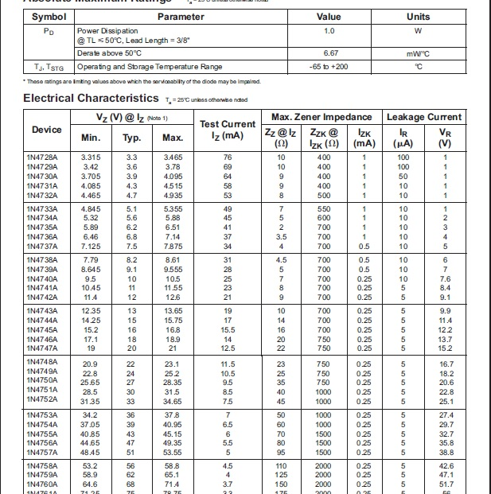
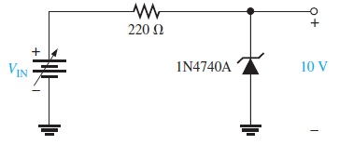

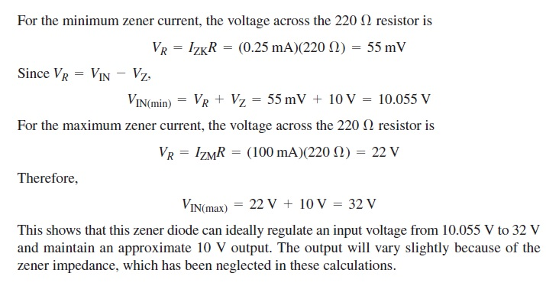
Zener Regulation with a Variable Input Voltage

Slide 12
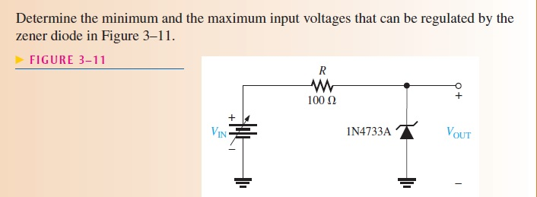

Slide 13
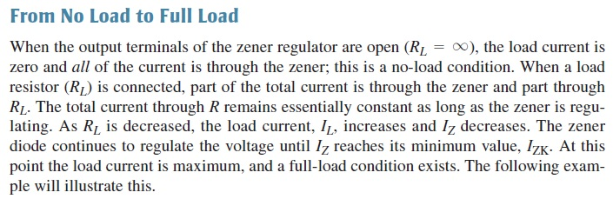
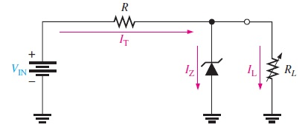
Zener Regulation with a Variable Load

Slide 14
